Slide 1
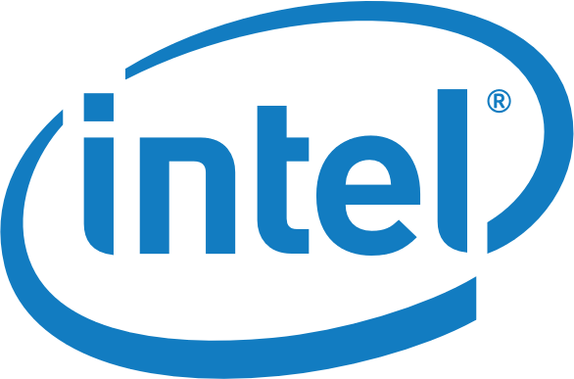
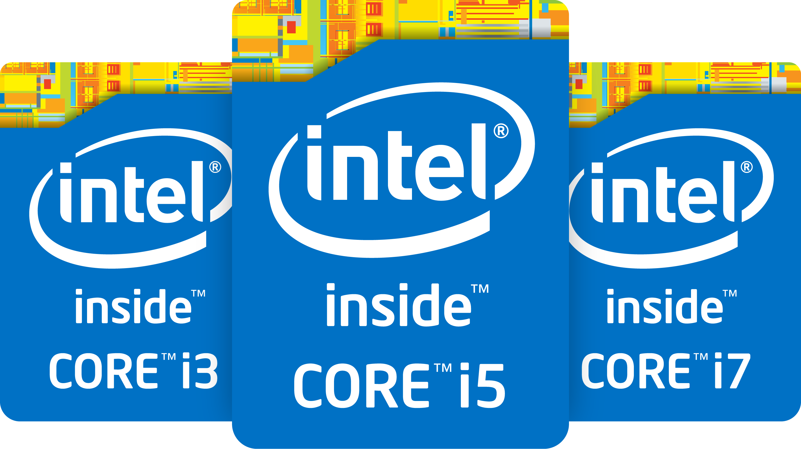
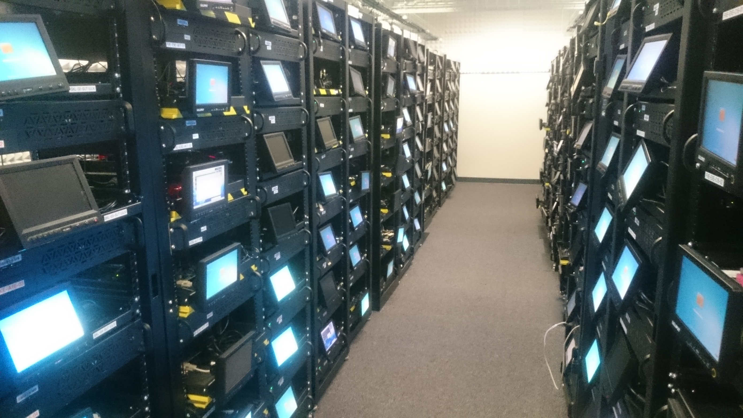
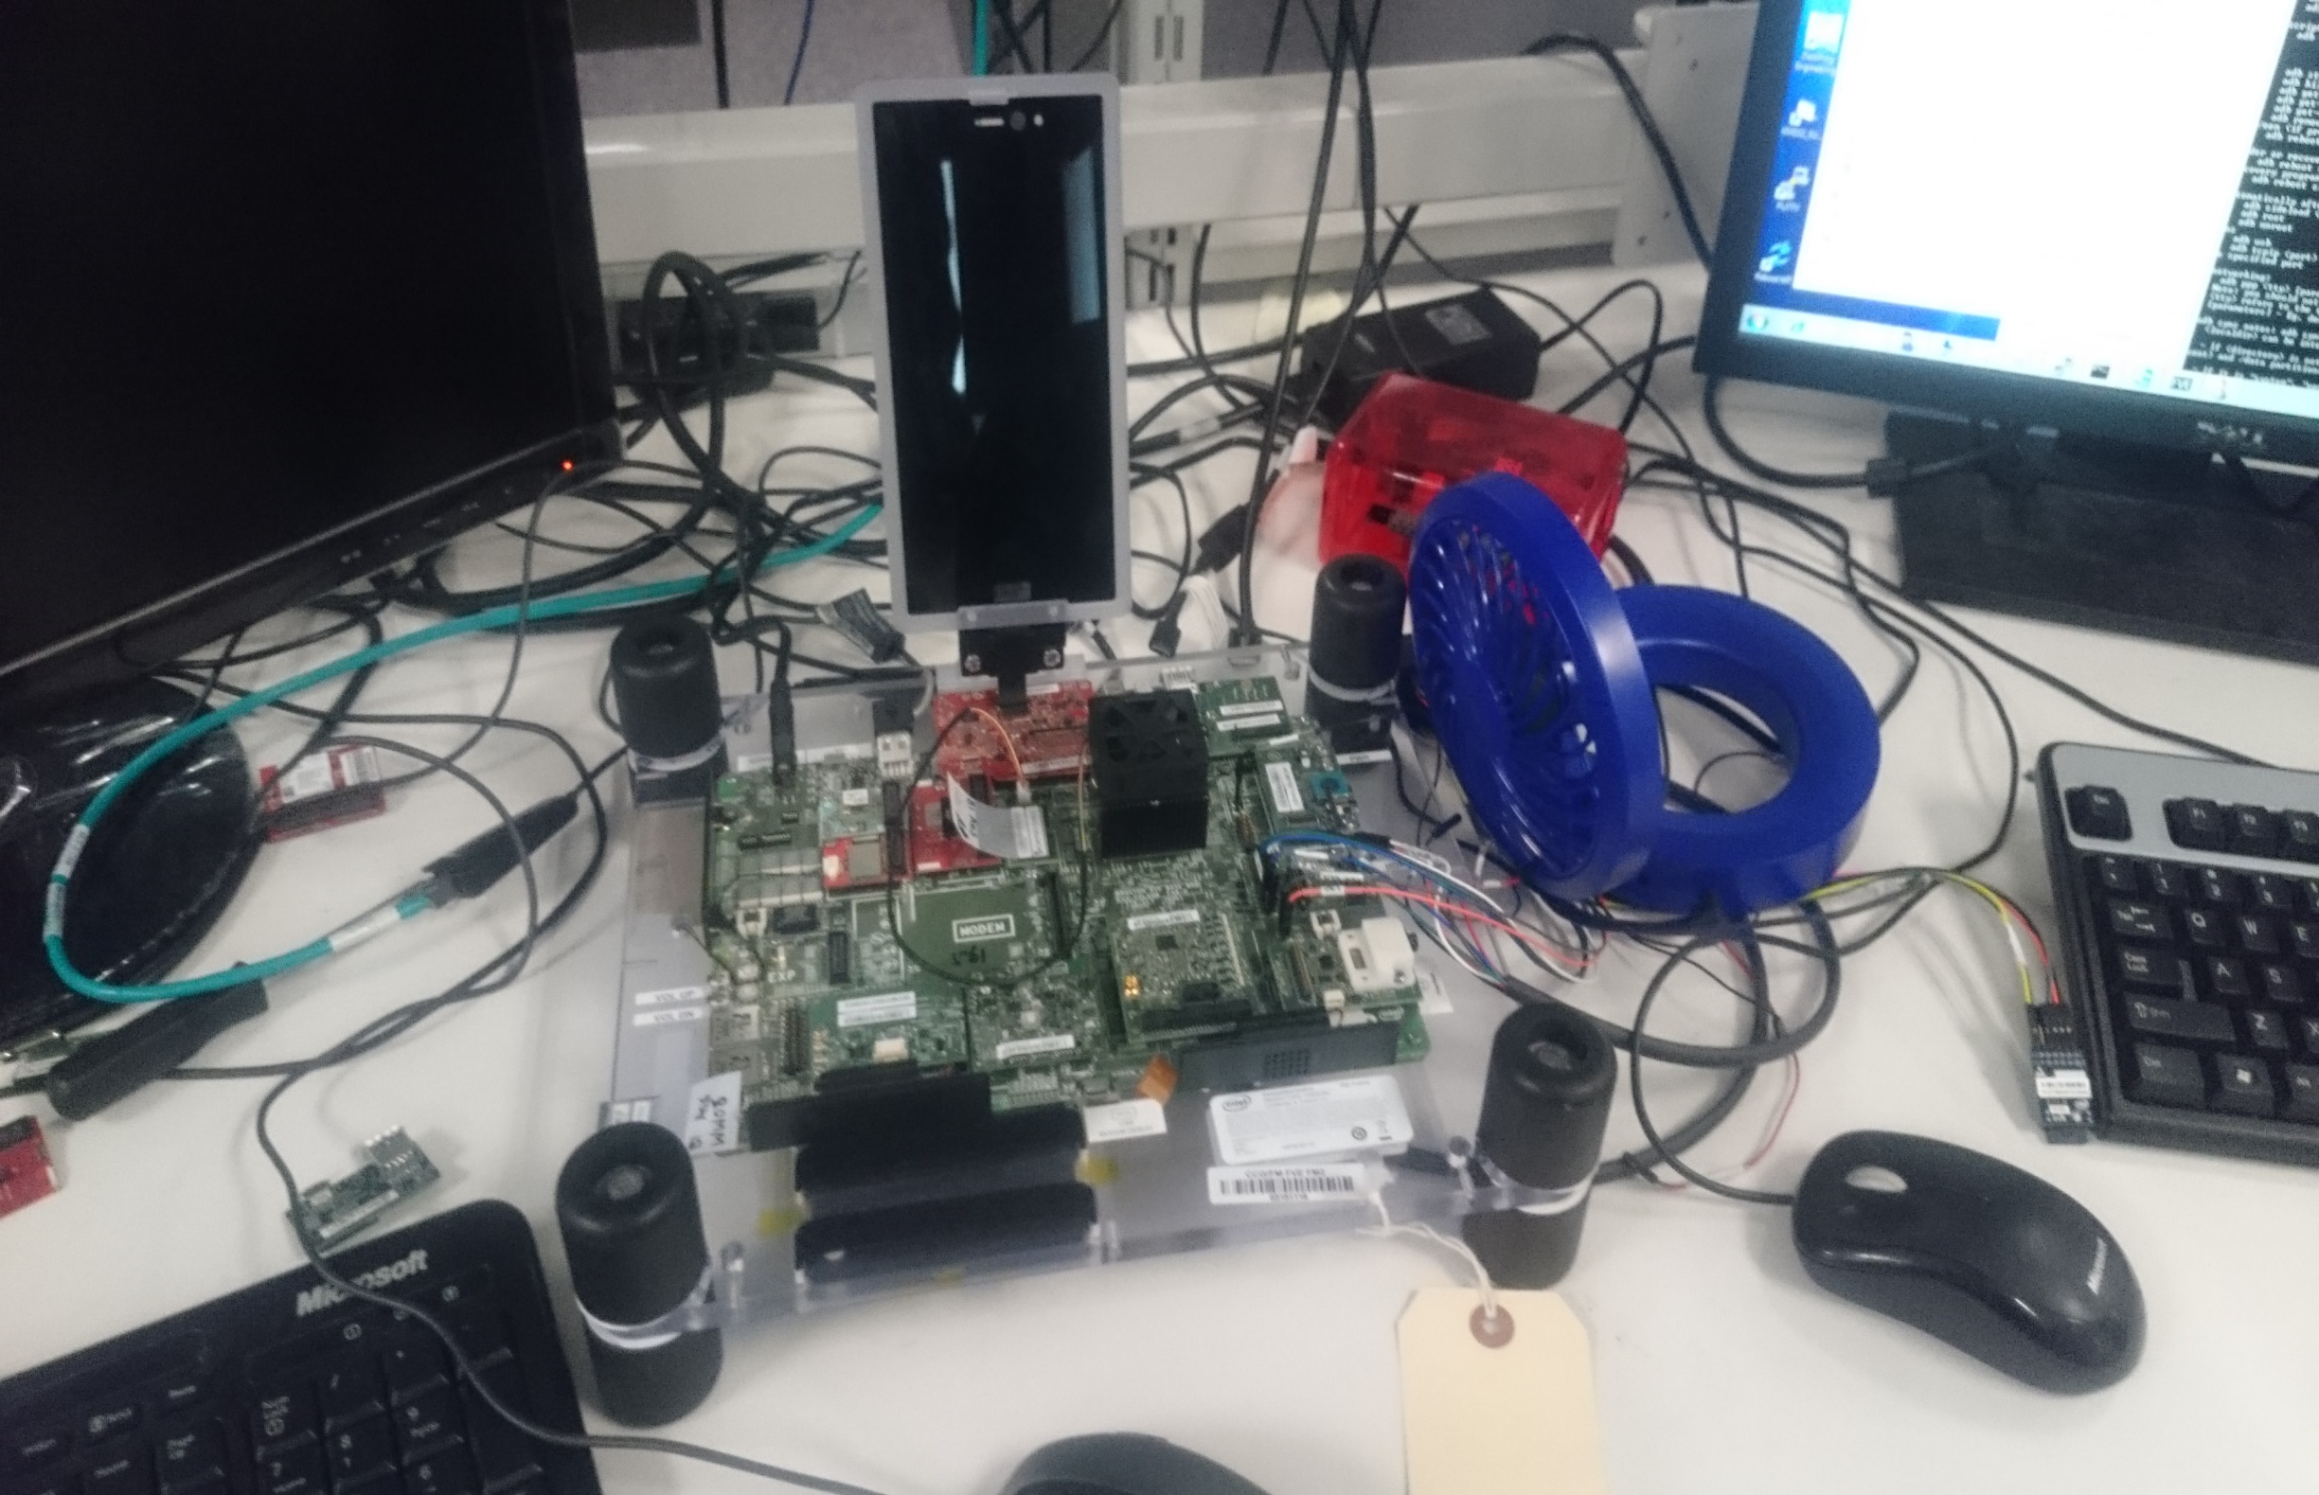
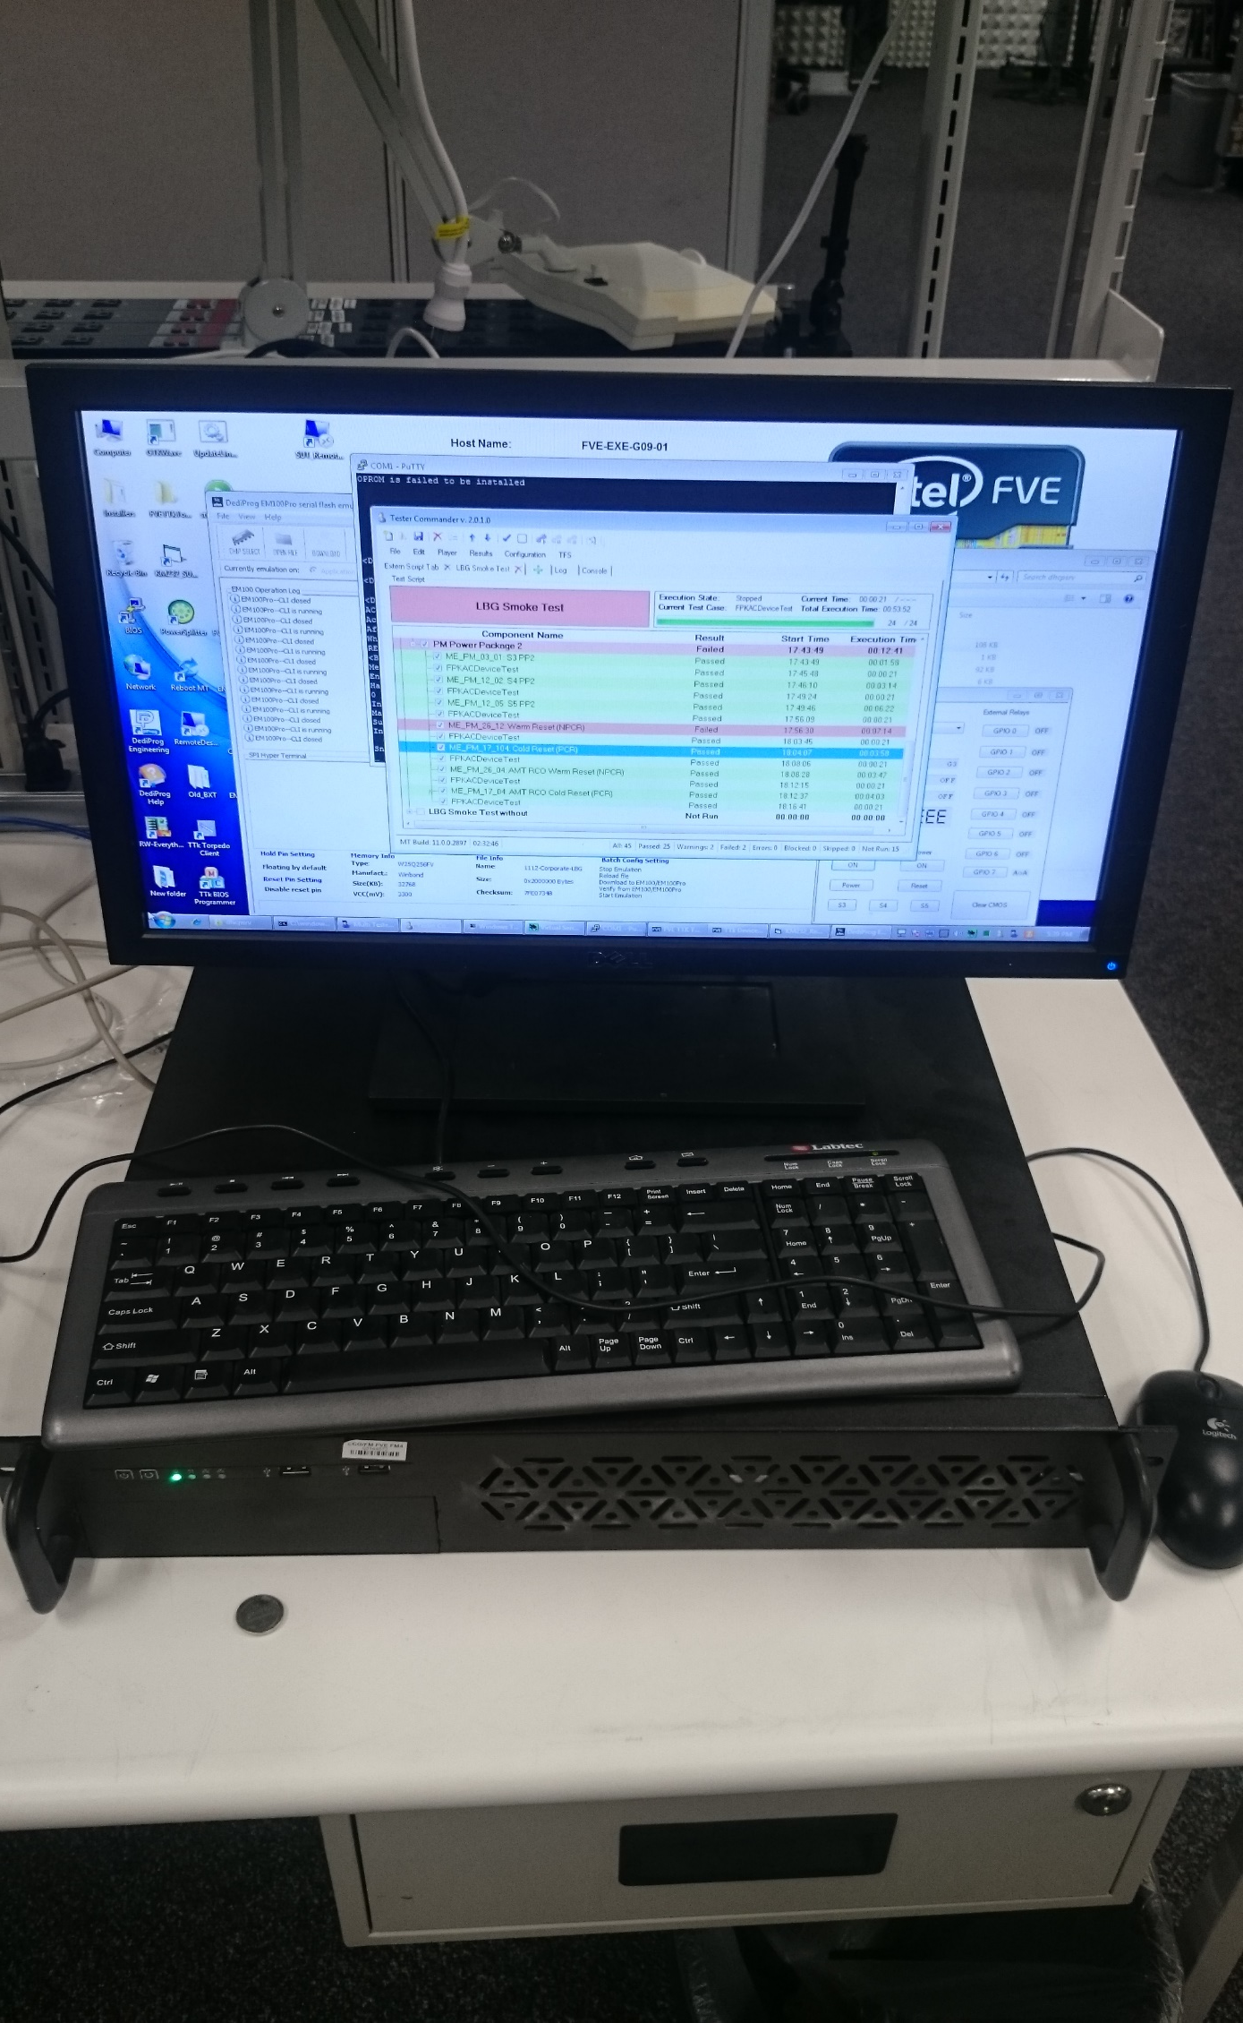
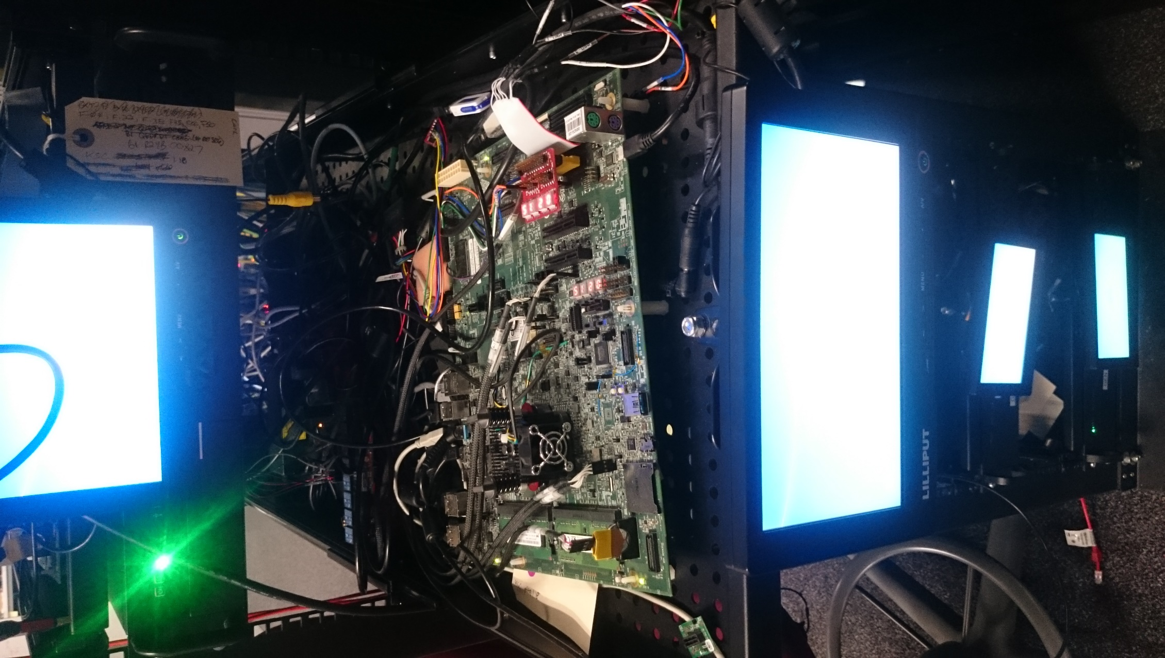
Software Engineering @ Kevin Duke
Background
I did a year long internship at Intel in Folsom, CA
The lab I worked in was the firmware testing lab, where we have many systems and platforms in which we use to test the newest firmware on the latest hardware. My role was a software engineer where I supported the team with automation or other entire projects such as chip virtualization.
Key Achievement
I figured out how to do BIOS traversal automation on Purely (Lewisburg) platforms which no one has been able to do yet and they were planning on a hard-coded solution. I was able to save them from doing this which opened up automation possibilities for hundreds of tests on many platforms. I went on to do it on Broxton as well.
Reflection
Taking this internship was one of the greatest experiences. I learned a lot how our skills transfer over to the work place and it really gave me a huge appreciation for school and classes. Classes that seem unimportant was seen having practical use in the workplace and I’m much more motivated to learn more at school.
UCSD Connection
During my internship, I used many skills from UCSD.
CSE 110: Teamwork and technicalities – In 110, we learned how to work in a team and how to implement design patters, which I used throughout my internship
CSE 100: Data Structures – I used coding skills and data structure knowledge at Intel
CSE 140: – Basics were useful around hardware
Perks
Working at Intel Folsom is right next to lakes and forests. Lake Tahoe is an hour away.
We get free drinks, coffee, fruits, and other snacks
Discounts! The latest processors and SSD’s are available for like 60%+ off

